Slide 1
Usage of Big Data in Social Work Research
Jia Xue, PhD
Assistant Professor
The Factor-Inwentash Faculty of Social Work
& Faculty of Information
May 29 , 2019

Slide 2
Overview
Who am I?
Why we learn Big Data?
Big Data for Social Justice Lab
Current Projects
People and Positions
Q & A
Notes:
I will talk about my personal and educational background, including practice experience, how I became interested in domestic violence research and social work. Then I talk about my research trajectory, followed by an example of my current study. Then I will talk about my future research plan, teaching and fit with the Uni of Toronto.

Slide 3



Who am I?
University of Pennsylvania
Ph.D. in Social Welfare
M.A. in Statistics
Harvard University
Research Fellow
(Pre-doctoral fellowship)
University of Toronto
Assistant Professor
Notes:
At Penn, I have extensive interdisciplinary research experience working with researchers from Nursing, Medical school and computer science. I also got my master degree in statistics from Wharton school.
Currently, I am working on my pre-doctoral fellowship at Harvard Kennedy school, where I work on an international sexual violence project.

Slide 4
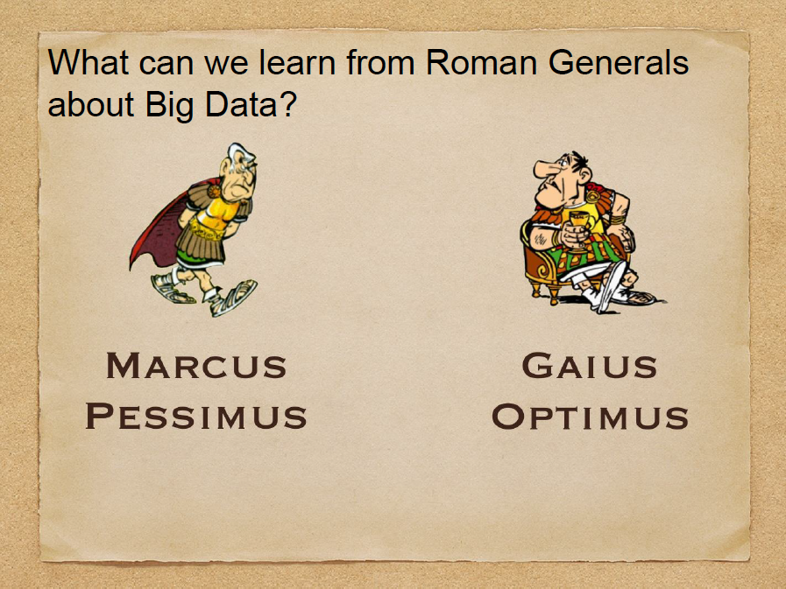

Slide 5
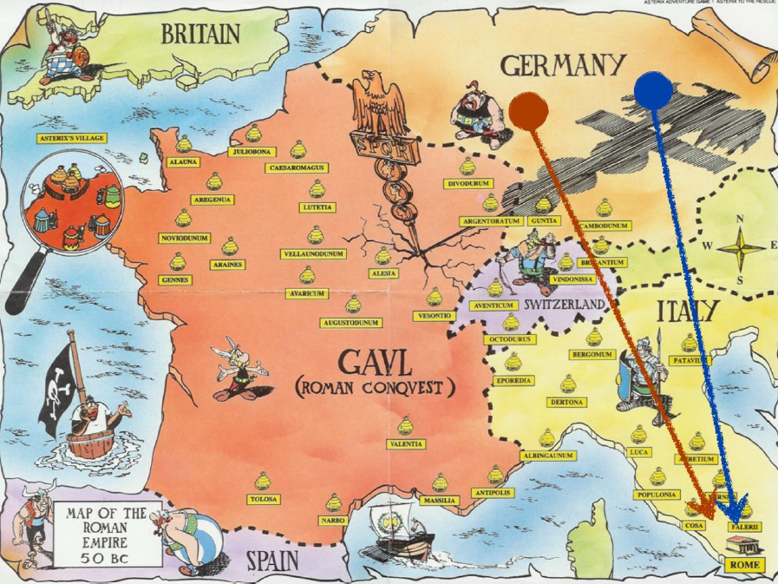

Slide 6
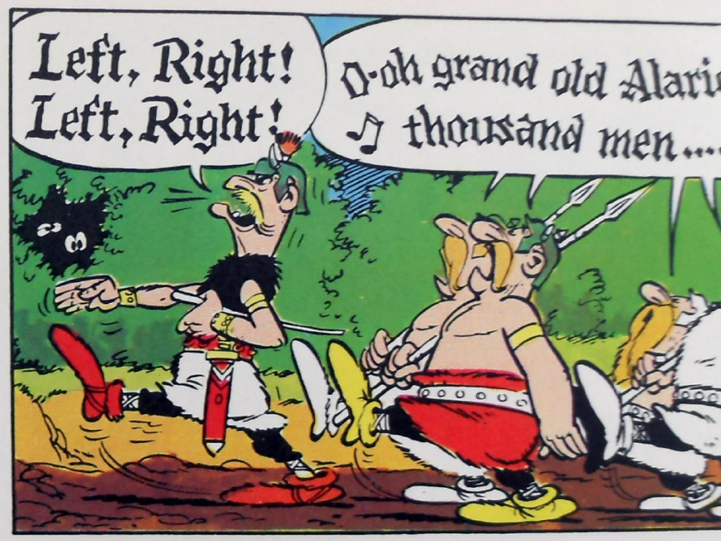

Slide 7


Slide 8
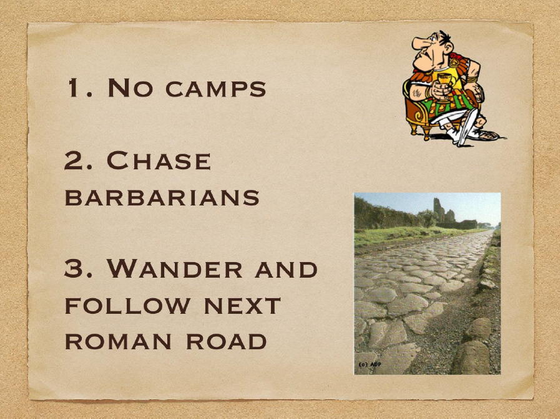

Slide 9


Slide 10



Slide 11
Why should we care about Big Data?
Unless you have been living in another planet, you must have heard the term

Slide 12
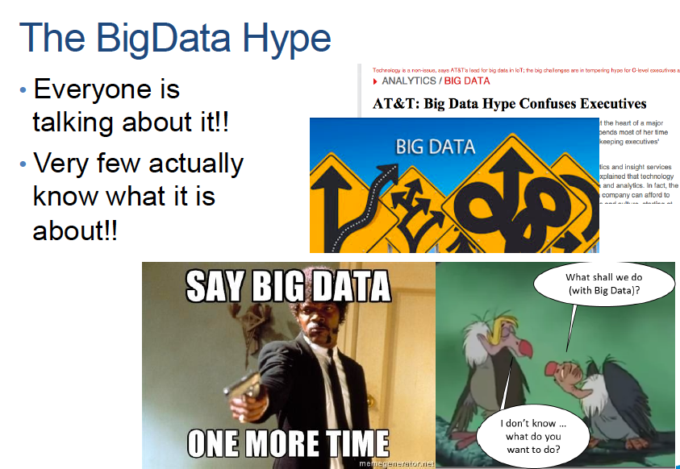

Slide 13
A definition of Big Data
“Big data” is a very subjective term
A data set of several terabytes
Many people are using significantly smaller data sets with great results
…
A definition from computer system perspective:
“Any data that cannot be captured, managed and/or processed using traditional data management.” (IBM).

Slide 14
5 Vs in Big Data
Notes:
Volume refers to the vast amount of data generated every second.
Velocity refers to the speed at which new data is generated and the speed at which data moves around.
Variety refers to the different types of data we can now use.
Veracity refers to the trustworthiness of the data.
Value refers to our ability turn our data into business value.

Slide 15
How to handle big data?
Scale up/vertically
Add resources to a single machine
e.g. CPU, memory, storage
Scale out/horizontally
Add more machines or clusters of machines

Slide 16
Two billion social media users in the world
81% of US population are using social media.
50% of Chinese population are using social media.
63% of Canadian population are using social media.
Notes:
Social media is growing rapidly these years. There are 2 billion social media users in the world. It is estimated that 81% of US population, 50% of Chinese population and 63% Canadian population are using social media.
The pictures here are popular metoo and time’s up campaign. Women who have been sexually harassed or assaulted post “#Me too” on social media, either sharing their own stories, or simply posting the hashtag to add their voices.
You know, for a long time, most women defined their own sexual assault as sth unspoken or sth to be ashamed of acknowledging. But now, social media provide a platform for victims to speak up, and empower victims to transfer their private experience into a movement, and get people to understand the prevalence of this problem in the society.

Slide 17
Timeline of Policy-Making of IPV: US & China
1960-1970
1971
Shelter, England
Women movement
1994
2000/05
1980
VAWA
2013
Re-VAWA
Re-VAWA
1970-1980
500 shelters in the US
Research
2001
1995, 09
Reform of Marriage Law
4th UN World Conference on Women in Beijing
2000
Mar. 2016
1995
1st provincial regulation against DV
Domestic Violence Law
Research grows
Notes:
1: this timeline shows the current stage of policy making of IPV in the U.S. and China.
2：we notice there is a 20 years lag between the U.S. and China.
When the U.S. passed the VAWA, the first federal legislation to address VAW in 1994;
China just started to recognize DV as a social problem under the influence of world conference on women held in BJ.
3: In 2000, 2005, and 2013, vawa has been reauthorized and improved services for all victims of domestic violence, sexual assault, dating violence and stalking.
It is a critical time to study policy making of IPV in China because the NPC is developing a comprehensive law against DV this year. There is positive political climate for a new law.
4: Many influential factors promote policy making.
For example, in the U.S., women’s movement, research, shelter services, they all inform the public and policy makers that family violence is a social problem, and made it clear for a need for legislation focusing on the prevention and treatment of VAW.
5: Based on two different stages of policy making on IPV between the U.S. and China, and a 20 years lag, and similar or different influential factors in the policy making process, I am motivated to do a comparison between the U.S and China in terms of policy making of IPV.

Slide 18
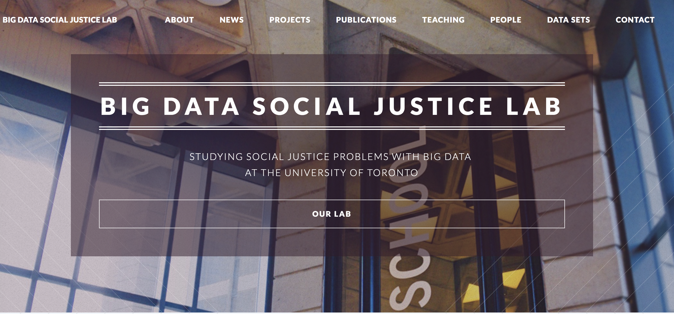
Big Data for Social Justice Lab
University of Toronto
Notes:
The Big Data for Social Justice Lab at iSchool dedicated to human-centered data science with two main missions, research and teaching.
RESEARCH
The Big Data for Social Justice Lab focuses its efforts to undertake new frontier research that tackles important questions at the leading edge of computational social science. The Big Data for Social Justice Lab applies the big data technics to the following research fields:
Intimate partner violence/dating violence
Sexual assault/violence, rape
Health Information Communication
Data mining
App/mobile design
Information communication technology
TEACHING
At a time when there is an ongoing public discussion about the responsible use of big data, the Big Data for Social Justice Lab inspires students to reflect on how big data can be used to promote social justice in innovative ways. The Lab offers Big Data and Data Science courses:
Statistics
Ethics, Vulnerable Population and Information Technology
Research Methods

Slide 19
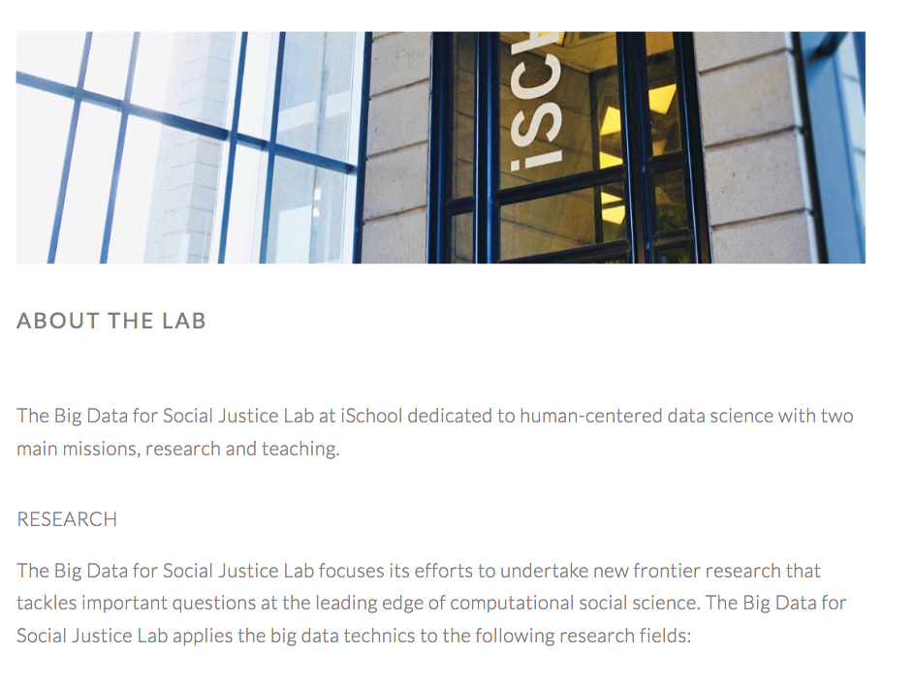

Slide 20
Research Areas
Violence
Intervention
Comparative
Intimate violence
Sexual violence
Mental Health
Suicide behavior
Big data
Machine learning
Mobile phone technology
Information
Communication
Technology
Technology-support
Artificial intelligence
Social media-based
Mobile phone apps
United States
China
Canada
Mobile health (mHealth) intervention for violence & health in a global context
Notes:
My research will continue to explore whether technology for example, social media, mobile phone apps can be used to deliver treatment.
The utilization of mobile phones to advance positive health outcomes is known as mobile health, or mHealth (Mechael 2009).

Slide 21


Slide 22
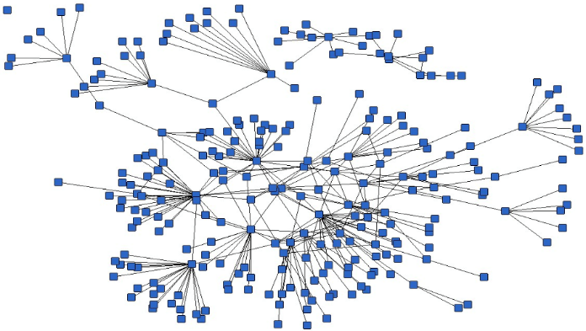
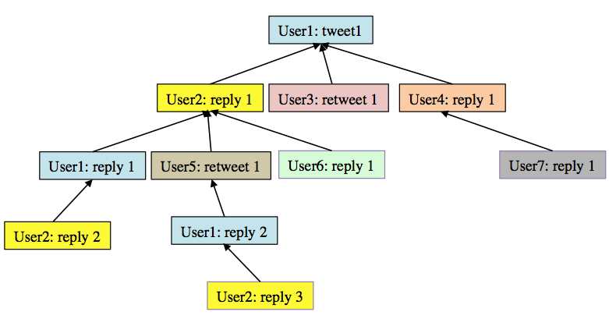
Conversational thread of violence against women-related topics on Twitter
Purpose: To explore how violence against women related conversations are presented on Twitter.
Method: 2.5 million Tweets, Naïve bayes classifier
Results: Conversations on VAW topics have more conversational responses than other topics, and the length of responses is longer. But the average number of retweets is substantially smaller than other topics.
Breadth-First Search Algorithm
Notes:
One example of computational social science methodology is my collaborative work with computer scientists.
The goal of this work is to explore how VAW related conversation are presented on Twitter. We crawled over 2 million tweets and used Naïve bayes classifier technique to classify topics.
Look at the top figure, it illustrate a Twitter follower graph (recursive algorithm, all the nodes are in the queue, and check if it has a path to the next. breadth first means we check the level by level to go wider,and then go deeper),
each square represents a Twitter user account. The figure at the bottom is an example of the Twitter conversation structure. It is also called Twitter conversation thread.
(1) Users; (2) Node; (3) arrow – link between nodes, incoming and outgoing. (4) find thread degree- the largest incoming links for the node; (5) depth;
For example, user2: reply 1 has one outgoing link and three incoming links. We find out the node with the largest number of incoming links within this conversation structure, which reveals of the degree of the conversation.
(5) retweet numbers. --- forward another user’s tweet to your followers and will show on your profile.
This indicators, examine the conversation thread, and compare to other topics.
Findings: higher degree, greater depth. What does it mean. It means compared to other topics, VAW topics have more responses, and length of responses is longer, but these conversations did not broadcast to a broader audiences. So implications for practitioners is to use Twitter’s retweet function as a advocacy tool.

Slide 23
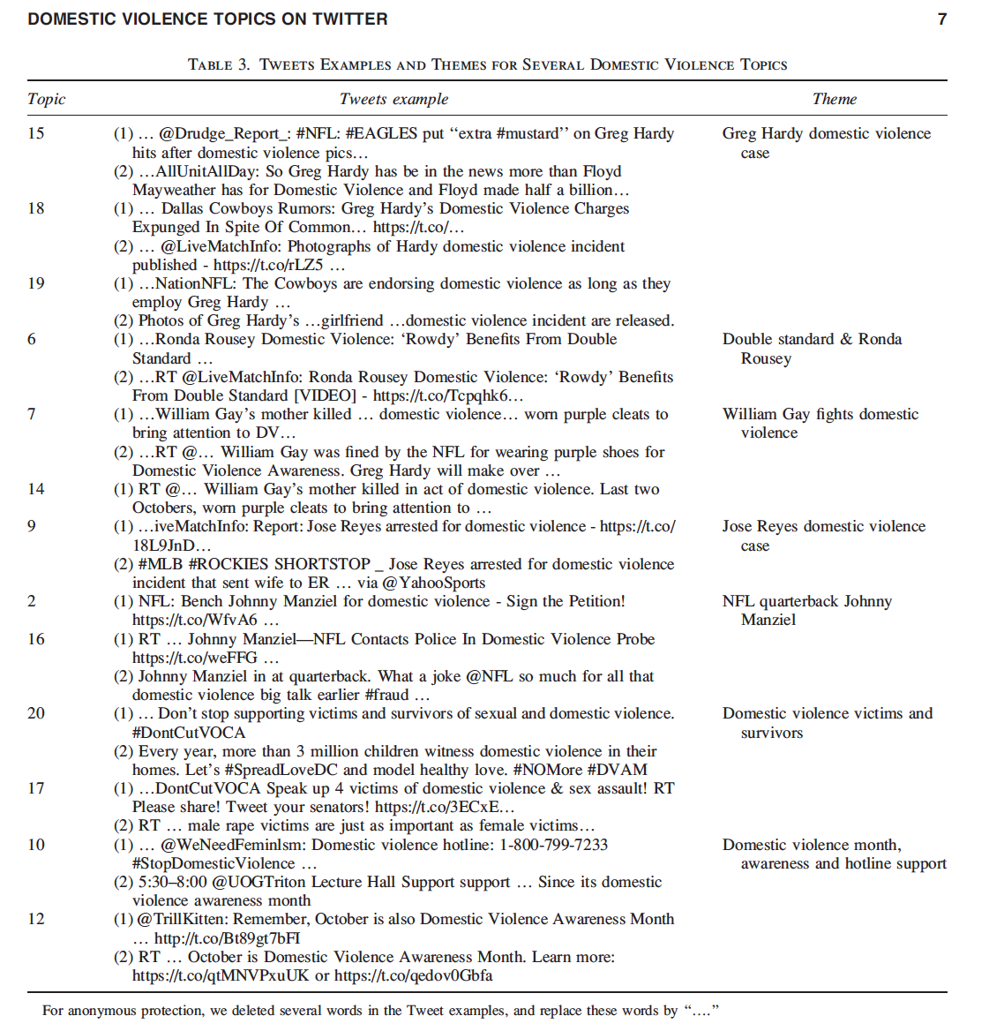
Using Data Mining Techniques to Examine Domestic Violence Topics on Twitter
Purpose: To explore the conversations and discussions regarding domestic violence on Twitter.
Method: API was used to collect 322K tweets containing key word “dv”. We configured LDA to generate 20 latent topic distributions.
Results: Two themes were found, including “victims” and “high-profile cases of dv” (male athletes use violence against women).

Slide 24
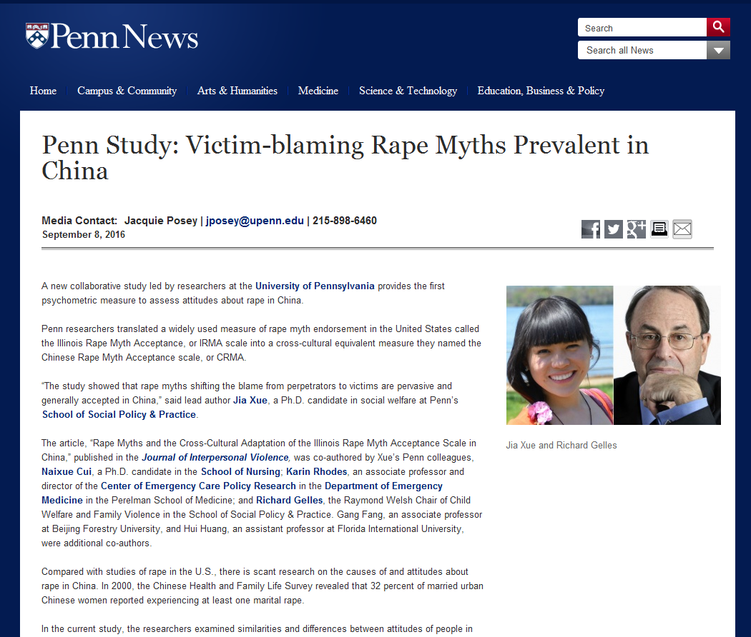
Rape Myths and the Cross-Cultural Adaptation of the Illinois Rape Myth Acceptance Scale in China
Purpose: To examine the similarities and differences in rape myths acceptance (RMA) in the US and China, and validate a Chinese-version of the RMA scale.
Method: Survey method. Sample is 975 college students in China. Exploratory factor analysis.
Implication: The validated RMA-Chinese scale can be widely used in rape prevention and victim support services and related research in China.
Notes:
One example of my international cross cultural research on sexual violence is the published work, titled rape myths and the cross-cultural adaptation of the Illinois RMA scale in China.
The goal of this study is to examine the similarities and difference in rape myth endorsement between the US and China.
I translated the widely used the scale named IRMA into Chinese, and used survey methods and collected data from about 1000 Chinese college students, from 6 cities. I used factor analysis to validate the Chinese version of the RMA scale, and came up with a Chinese version of rape myth acceptance scale, with a five factor model, such as victims are responsible for rape, rapists’ motivation to rape, false allegation about rape. We also found male students are more likely than female students to blame the victim, for the rape.
The study is the first psychometric measure to assess the attitude toward in China, and has great implications in rape prevention and rape victim support services in China.
Face, than caucasin to blame women.

Slide 25

Using Big Data from Social Media to Examine the Impact of Domestic Violence on Mental Health
Week 1
Week 2
Week 3
Week 4
Prediction
model
Suicide Probability
Before
Depression
Features
extraction
LIWC + Behavioral
features
Life Satisfaction
First DV incident
(e.g. “Last night, my husband hit me for the first time.”
Mar 12th, 2019, 7:02am)
232 posts from the victim group
232 posts from the non-victim group
Prediction
model
Week 5
Week 6
Week 7
Week 8
Suicide Probability
Depression
After
Features
extraction
LIWC + Behavioral
features
Life Satisfaction
Notes:
The IPV victim group, the scores of depression increased significantly. The Child abuse victims group experienced significant increased depression and a decrease in satisfaction with life. Exposure to DV victims have increased hostility and suicidal ideation.
To summarize the key findings.
Victims in general had increased levels of depression and suicide risks, and decreased life satisfaction after their first reported DV incidence. Impact of DV experience on mental health outcomes differed by DV types. Victims of IPV showed more depression symptoms after DV incident. Abuse children experienced increased depression and dissatisfaction with life. Victims of exposure to DV had increased suicidal ideation and hostility.

Slide 26
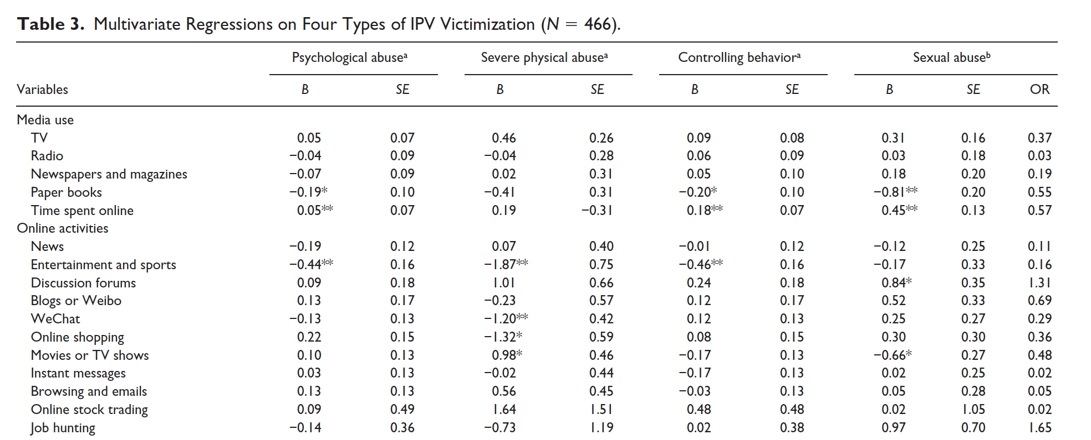
Information Communication Technologies and Intimate Partner Violence in China
Purpose: To assess the impact of using ICT on Chinese women’s experience of IPV.
Method: Face-to-face survey interviews with 300 women. Dependent variables were women’s experience of four types of IPV. The independent variables include media use and online activities.
Results: Browsing online entertainment and sports news is consistently associated with lower levels of violence. Watching online movie and TV shows is positively predicting severe physical assault and associated with lower rates of sexual abuse.

Slide 27

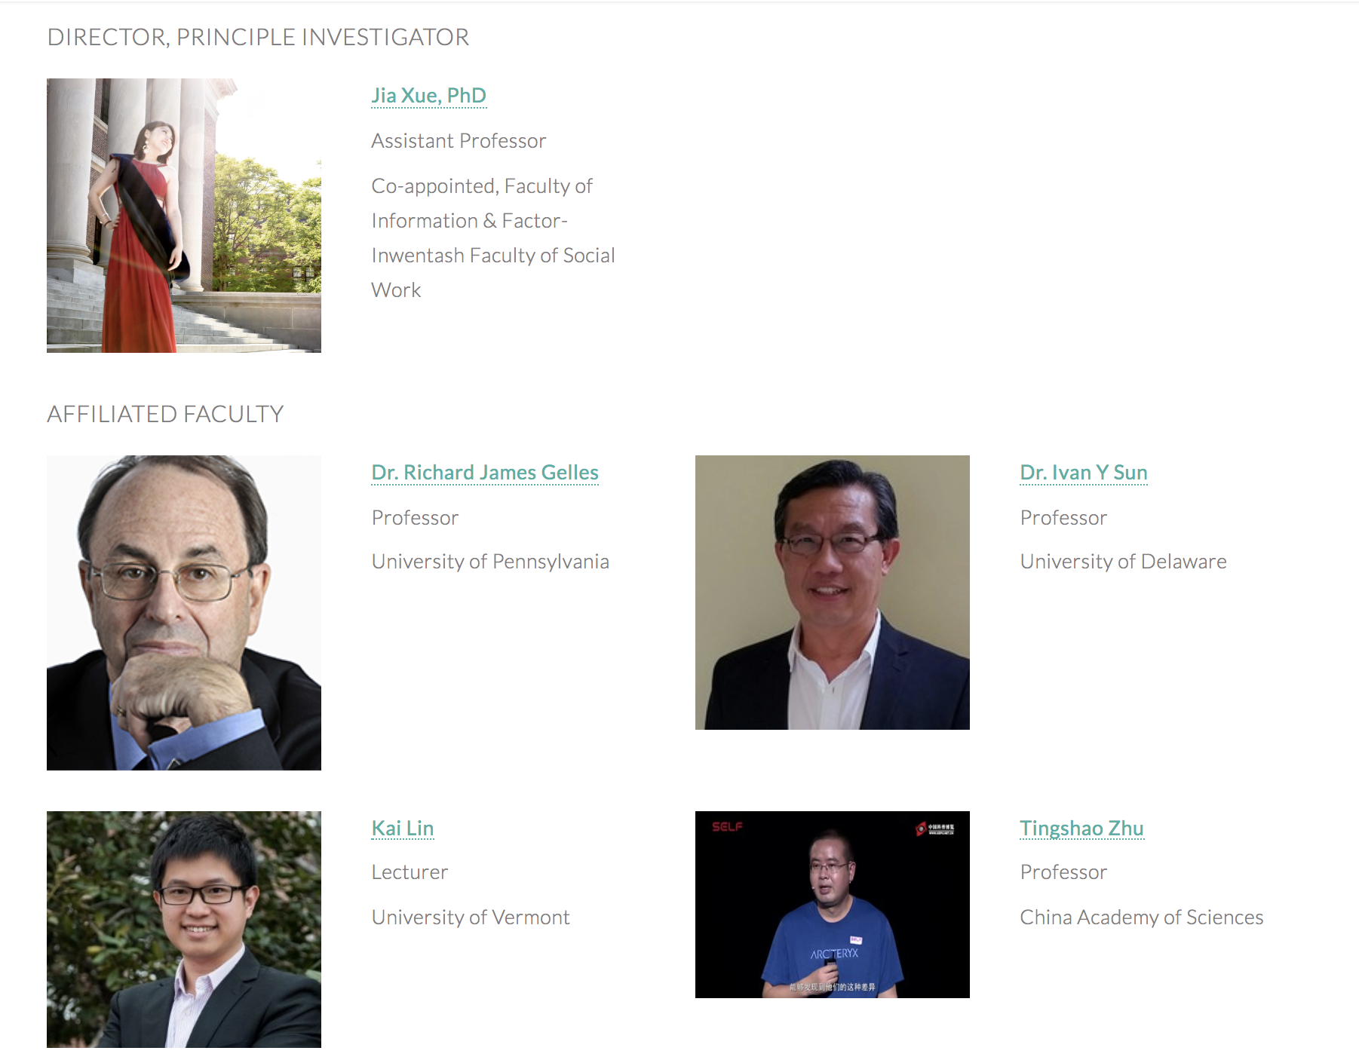

Slide 28

Jia.xue@utoronto.ca
Jia Xue
@Emma_jia _xue
Emma Jia Xue
EmmaXue
Emma Jia Xue
Notes:
Thank you very much and questions.

Slide 29
Intimate Partner Violence (IPV)
China
U.S.
Definition
Domestic violence
The use of means such as beatings, restraints, harms, or forcible restrictions on physical liberty to commit injurious acts against family members (NPC, Domestic Violence Law Draft).
Physical violence
Sexual violence
Psychological aggression
Stalking
Current/former intimate partner
Heterosexual/same-sex couples
Notes:
1: In the U.S., many terms have been used to describe this phenomenon, such as wife abuse, wife beating, family violence, domestic violence, VAW, and also IPV.
2: in contrast, In china, the term domestic violence has been dominantly used.
DV in China mostly focus on physical harm against family members and does not include dating violence. In addition, includes child abuse and elder abuse.
3: In the U.S., IPV includes PV, SV. PV, Stalking, among current or former intimate partner, and could happen between heterosexual or same sex couples.
4: In this study, I use the term IPV and the definition in the U.S. as a consistent definition both for the U.S. and China.

Slide 30
Intimate Partner Violence (IPV)
Prevalence of IPV Victimization (Lifetime)
Type | United States |  | China
 | Female (%) | Male (%) | Female (%)
Any form | 35.6% | 28.5% | 33% Marital violence
Physical violence | 32.9 | 28.2 | 7.8~96.7
Severe physical violence | 22.3 | 13.8 | NA
Psychological violence | 48.4 | 48.8 | 3~88.1
Rape | 9.4 | NA | 5.8~62.9
Other sexual violence than rape | 16.9 | 8.0
Stalking | 10.7 | 2.1 | NA
The National Intimate Partner and Sexual Violence Survey (2011), All-China Women Federation, Intimate Partner Violence in Chinese Societies (Chan, 2011)
Notes:
1: IPV is a serious social problem both in the U.S. and China.
2: The National Intimate Partner and Sexual Violence Survey (2011) reported that about 35.6% of women experience some form of IPV in their lifetime, such as rape, physical violence or stalking.
3: In China, there is still no national representative survey on the prevalence of IPV. Studies in different parts of China, using samples and instrument show big variations of the prevalence.
All-China Women federation shows that about one third of married women are abused by their husband in their lifetime.
4: Despite a high rate, China does not have a national law that directly and comprehensively address IPV.

